Slide 1
Mission of AZEC in the Future
Hiroyuki “Hiro” TAKAHASHI
President
Japanese Zoo and Aquarium Educators (JZAE)

Slide 2
Contents
Introduction – Who am I ? –
History of AZEC
Mission of AZEC in the Future

Slide 3
Contents
Introduction – Who am I ? –
History of AZEC
Mission of AZEC in the Future

Slide 4
Introduction
Keeper (Primates), Chiba Zoo
President, Japanese Zoo and Aquarium Educators
Regional Representative (North and South East Asia), International Zoo Educators Association (IZE)
IZE @ Hong Kong

Slide 5
JAPAN
Chiba City
TOKYO
TAIWAN
Notes:
You may wonder where Chiba Zoological Park is. This is Japan, and this is Taiwan, and… this is…Singapore!
Now Tokyo is here, located in a center of Japan.
And Chiba City is here, located in the east side of Tokyo.
Before starting my today’s topic, I would like to say “thank you” for your concern and your warm words of encouragement
when the great earthquake and Tsunami attacked Japan last year.
The earthquake and Tsunami did extensive damage to the coast of north- eastern part of Japan, but fortunately there is not so serious effect around our place.
I am still alive, so...
I am very honored to be able to stand here and am very glad to meet you all again.
Now take a look at this area (押）more closely.

Slide 6
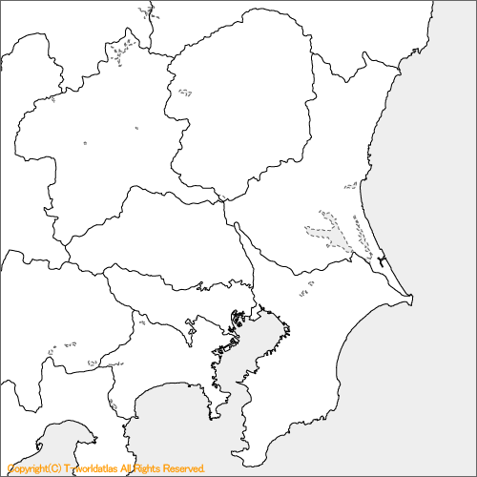
JAPAN
TOKYO
CHIBA CITY
Chiba City
TOKYO
Notes:
This is the Tokyo metropolitan area… Tokyo is here, and Chiba City is here.
It takes about 45minutes from the center of Tokyo to Chiba City by train.
Chiba City is the capital city of Chiba Prefecture.
Chiba Prefecture looks like a triangle, so… this is the Chiba Zoo logo… you can see a Gorilla’s face and… this triangle symbolizes Chiba Prefecture.
And the eye stands for Chiba City.

Slide 7
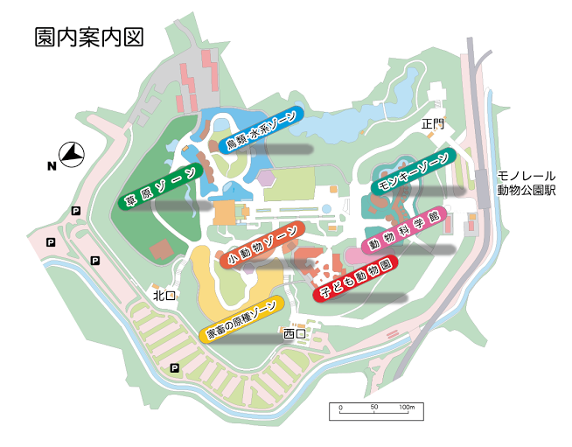
33 ha.
Avian & Aquatic Zone
Primate Zone
Steppe Zone
Small Animals Zone
Animal Science Hall
Opened in 1985
Children’s Zoo
Under Construction
Notes:
This is a whole map of Chiba Zoo. Chiba Zoo is opened in 1985.
Chiba Zoo is a member of WAZA and JAZA – Japanese Association of Zoos and Aquariums -.
And I am a member of IZE!
Chiba Zoo consists of 7 zones.
These are Monkey Zone, Animal Science Hall, Children’s Zoo, Ancestors of Domestic Animals Zone, Small Animals Zone, Steppe/Savanna Zone, and Avian & Aquatic Animals Zone.
Its total area is 33 hectares. (82 acres).

Slide 8
The Japanese Zoo and Aquarium Educators (JZAE)
– The most historic study group about zoo and aquarium education in Japan –
We call ……
Zoo Kyoh Ken ♪（Zoo教研）
©Shigefumi Kanao

Slide 9
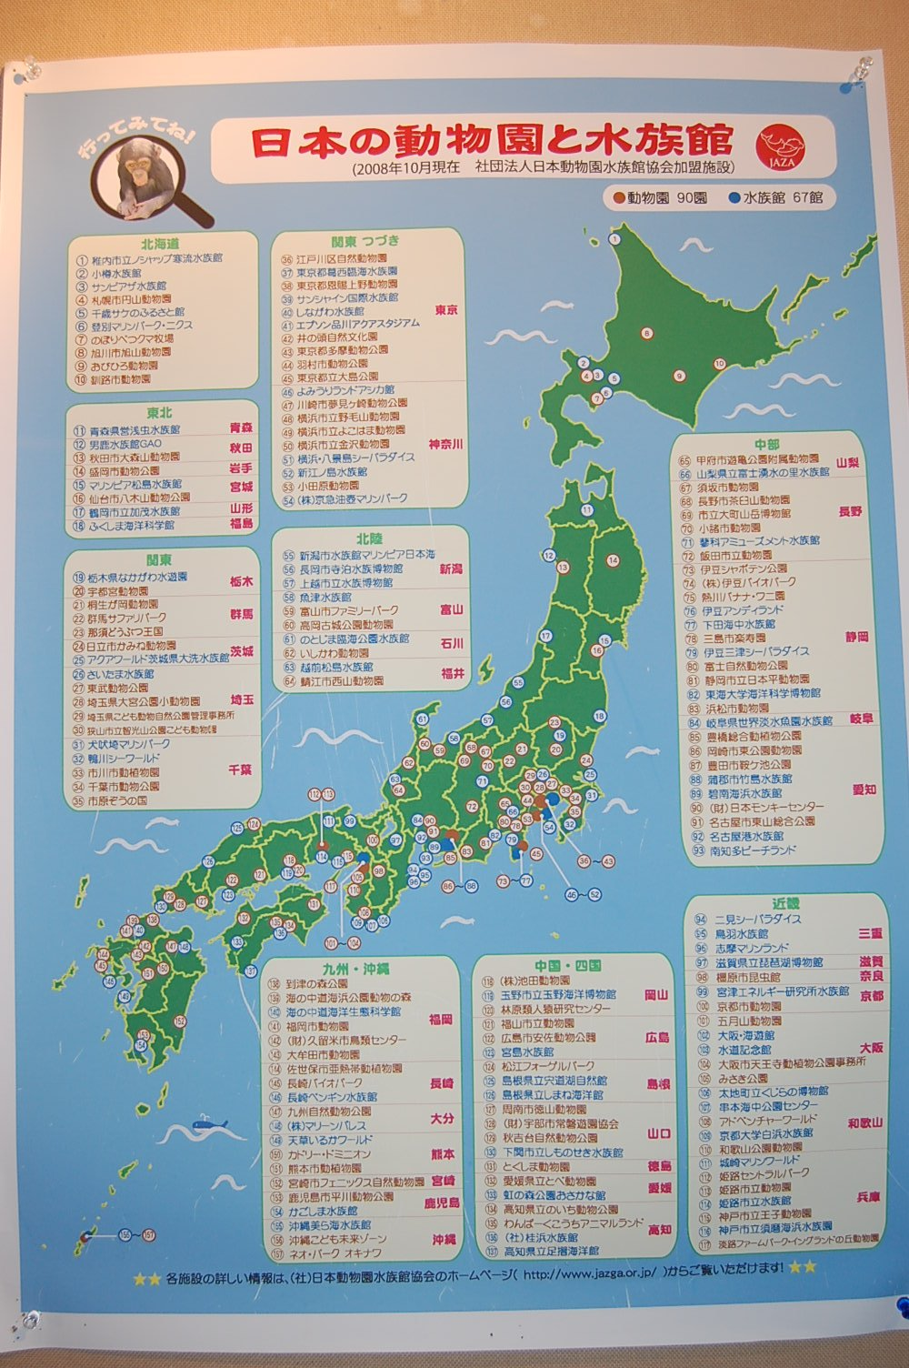
From Hokkaido Island to Okinawa Island,
There are 91 zoos and 57 aquariums in Japan.
※They belong to JAZA (Japanese
Association of Zoos and Aquariums).
※JZAE (Japanese Zoo and Aquarium
Educators) accepts not only
zoo/aquarium educators, keepers under
JAZA, but also other professionals such
as teachers, students, company workers
etc.

Slide 10
■JZAE was born in 1975, and it is the 44 years anniversary in 2019.
※IZE was founded in 1972.
■It is the most historic study group about zoo and aquarium education in Japan.
■The 175 members participate and are registered in 2015. (+18 Affiliate & Corporate Members)

Slide 11
Contents
Introduction – Who am I ? –
History of AZEC
Mission of AZEC in the Future

Slide 12
History of AZEC
2007 The 1st Singapore Zoo
2009 The 2nd OceanPark Hong Kong
2011 The 3rd Taipei Zoo
2013 The 4th Marine World
Umi no Nakamichi, Fukuoka
2015 The 5th Seoul Zoo
2017 The 6th National Museum of Marine Biology & Aquarium,
Taiwan

Slide 13
The 1st AZEC 2007 @ Singapore Zoo

Slide 14
AZEC 2007 (Singapore)
6th – 10th September, 2007 @ Singapore Zoo
About 56 deligates, 11countries
“The need for a platform for the exchange of ideas among Asian Zoo Educators has always been deeply felt, so initiation was taken by the Singapore Zoo to fill this gap, leading them to host the first Asian Zoo Educators conference.” (Ms. Rachana Shah from Central Zoo, Nepal, 2009)
The theme: “Engage, Educate, Conserve”
Emphasized: How the zoo all over can and is helping in education about the wildlife and environment education and how crucial role they play in the society.

Slide 15
AZEC 2007
Not only keynote speech but also over 26 oral presentations and 8 poster presentations.
Modern zoos have moved on and become important centers for not only children but also visitors all aspect of our natural world.
The attendants had opportunities to learn by visitors different facilities and sites with a behind the scenes tour of Singapore Zoo, a visit to Underwater World, the Singapore Science Center and other places.
(Ms. Rachana Shah from Central Zoo, Nepal, 2009)

Slide 16
AZEC 2007
Future planning
Share attendants experiences with zoo educators in their countries.
Create awareness among zoo visitors by preparing leaflets, posters, bill boards etc.
Organize talks for students and others.
Organize zoo visits for disabled students and others.
Develop a regular education programme involving zoo educators and students.
(Ms. Gawsia Choudhery, Wildlife Trust of Bangladesh)

Slide 17
AZEC 2007
The outdoor sessions included interacting with the Singapore Zoo Staff and learning from the “what”, “why” and “how” of the education programmes carried out the zoos.
(Ms. Meena Nareswar, Center for Environmental
Education, India)
☆The report was submitted by Ms. Sally Walker,
IZE Regional Representative of South Asia

Slide 18
If I were there ~
(.>o<.);…

Slide 19
The 2nd AZEC 2009 @ Ocean Park Hong Kong

Slide 20
AZEC 2009, Hong Kong
The second conference was held in 2009 at Ocean Park Hong Kong.
58 individuals representing 29 organizations participated the conference.
The theme of the 2009 conference was “Saving the melting earth with limited resources but immense ideas”

Slide 21
Hiro and Hide

Slide 22
Workshop (What are the key components in interpretation?)

Slide 23
Bird Watching

Slide 24
Translation (from Chinese to English)

Slide 25
Try a local food in Hong Kong

Slide 26
Good opportunity to meet each other among Asian friends

Slide 27
Meet a good friends

Slide 28
Farewell Party

Slide 29
Let’s a sing a song!

Slide 30
Thank you for your great hospitality, my Hong Kong friends!!

Slide 31
The 3rd AZEC 2011 @ Taipei Zoo

Slide 32
AZEC 2011, Taipei, Taiwan
September 18-22, 2011.
The Theme: “Focus On Rainforest ‧ Eco-System Thinking”
Participants of the conference shared their perceptive insight on the conservation of our natural resources and the protection of the valuable ecosystem.

Slide 33
Hiro, Hide and Dr. Koji TAKADA

Slide 34
Hiro, Hide, Kasumi and Dr. Koji TAKADA

Slide 35
Education Center in Taipei Zoo

Slide 36
First Oral Presentation at AZEC

Slide 37
After Hiro’s presentation … Photos!

Slide 38
Coffee Break!

Slide 39
Taipei Zoo Visit ……Naturalistic exhibit

Slide 40
The exhibit is for River Otters

Slide 41
The Panel of invasive species

Slide 42
The Corner for Biodiversity

Slide 43
The panel says “Respect for Life”

Slide 44
The panels are in front of the Toilet

Slide 45
The Panels show each species Poos!

Slide 46
Workshop at Taipei Zoo

Slide 47
Hiro did it!
Hiro made it!
The Japanese Macaque Lantern!
People in Taiwan celebrate the Lantern festival each year ♪

Slide 48
Educators have enjoyed Taiwanese local food and learn its regional culture.

Slide 49
The 4th AZEC was decided in Japan!

Slide 50
Thank you for your hospitality, Taipei Zoo!

Slide 51
The 4th AZEC 2013 @ Marine World Umi no Nakamichi, Fukuoka, JAPAN

Slide 52
AZEC 2013, Fukuoka, JAPAN
December 9 (Mon) – December 13 (Fri), 2013
The Theme: “Educational Cooperation between Museums for Humanities and Sciences - A message for creating new life through linkages - ”
230 from 16 countries and regions (the United States, India, Indonesia, Kazakhstan, Congo, Singapore, Sri Lanka, Thailand, Nepal, Bangladesh, Vietnam, South Korea, Hong Kong, Taiwan, China, Japan)
38 oral presentation, 34 poster sessions, 4 workshops
The 4th AZEC and the 54th JZAE Joint Conference

Slide 53
The 4th AZEC was hosted by JZAE (Japanese Zoo and Aquarium Educators) and Marine World Umi no Nakamichi

Slide 54
Venue
The Luigans Spa & Resort

Slide 55
Welcome Party

Slide 56
Welcome Party

Slide 57
Poster Session

Slide 58
Poster Session

Slide 59
Poster Session

Slide 60
Poster Presenters

Slide 61
A Big Group Workshop
The workshop was conducted under the direction of Mr. Yoichi Sadotomo (Nihondaira Zoo Guide volunteer/ Now Fulltime Lecture of Teikyo University of Science). In small groups, new approaches were discussed and opinions were actively exchanged based on research presentations, tours of facilities and the constructed network of participants, etc.

Slide 62
A Small Group Workshop
Ms. Akemi Matsumoto (Institute of teaching materials for Animals, Pocket) “Collaboration with School Education and Assessment of Its Educational Effect on Children”

Slide 63
Japanese Style Get-together Party

Slide 64
Farewell Party (Singing each countries song!)

Slide 65
Farewell Party (Singing each countries song!)

Slide 66
Thank you for coming to Fukuoka, Japan!

Slide 67
The 5th AZEC 2015 @ Seoul Zoo, South Korea

Slide 68
AZEC 2015, Seoul, South Korea
Theme:
Conserving the Natural
Environment and Biodiversity
in Asia
- Biodiversity: Embrace it,
Share it,
Celebrate it! –

Slide 69
Icebreking Party

Slide 70
Icebreking Party (Japanese friends)

Slide 71
Korean’s executive members and invited guests

Slide 72
Venue

Slide 73
Dr. David Chen was the first presenter

Slide 74
Dr. Shin-Il JO

Slide 75
Mr. Danudet “Danny” CHANHOM

Slide 76
ZPO

Slide 77
Rachel had a keynote speech

Slide 78
The presenters were celebrated

Slide 79
Friends from Indonesia

Slide 80
The Entrance of Welcome Party

Slide 81
Welcome Party

Slide 82
Greetings from ZPO

Slide 83
Poster Presentation about ZPO’s Volunteer

Slide 84
Bird Watching at DMZ (Demillitarized Zone)

Slide 85
Coffee Break Settings

Slide 86
Seoul Zoo Trip

Slide 87
Seoul Zoo has joined ……
WAZA
SEAZA

Slide 88
Seoul Zoo has joined ……
ISIS (now Species360)
IZE

Slide 89
Keeper’s Note

Slide 90
Keeper’s Note about Poo and mouth of rhino

Slide 91
Specimen Room

Slide 92
Educational Panels in Specimen Room

Slide 93
The Exhibit Info for Tiger
And……

Slide 94
History
Conservation
Ecology
Culture

Slide 95
Husbandry Training for elephant

Slide 96
Husbandry Training for elephant

Slide 97
The panel for super powerful heart of giraffe

Slide 98
The Panel for introducing Zoo People

Slide 99
The Farewell Party was on a luxury cruiser

Slide 100
Wonderful Farewell Party on the ship

Slide 101
What is this box……?

Slide 102
Lots of beautiful cakes…… Thank you for your hospitality, Korean Friends!!

Slide 103
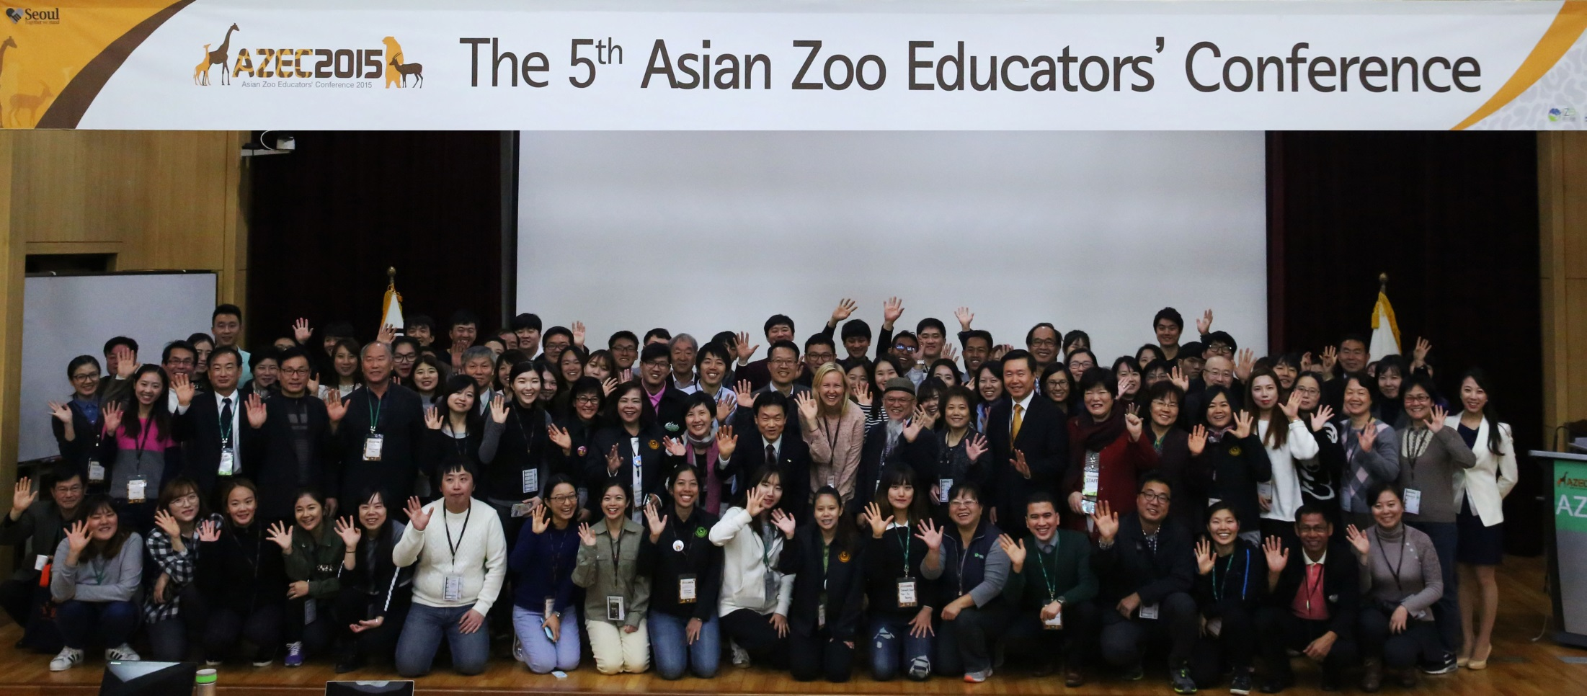
Thank you for your hospitality, my Korean friends!!

Slide 104
The 6th AZEC 2017 @ Pingtung, Taiwan

Slide 105
AZEC 2017, Pingtung, Taiwan
“Dance with the Popular Science Education”
The theme reflects the international science communities have paid attention to popular science communication recently. The science education is the fundamental of the popular science communication, and the scientific knowledge is delivered by understandable and motivating approaches with various media. The conference will also consult with Asian zoo educators, to allow experts and scholars from the fields of science education, popular science communication as well as zoo educators to gather together to share and discuss by means of keynote speeches, seminars, paper presentation and workshops.

Slide 106
AZEC 2017, Pingtung, Taiwan
☆The conference provides chances:
To support the connection, exchange and development of popular science education dialogue internationally.
To encourage the collaboration between formal and informal science educators.
To promote the citizen awareness of wildlife conservation and biodiversity.
To exchange innovative ideas and techniques for formal and informal science education.
To offer opportunities for researchers and scholars to exchange research and instructional practices in formal and informal science education.

Slide 107
AZEC 2017, Pingtung, Taiwan
November 9 (Thursday) to November 12 (Sunday), 2017
Venues: National Pingtung University
Organizers: Association of Science Education in Taiwan (ASET)
Department of Science Communication,
National Pingtung Universitiy
National Museum of Marine Biology & Aquarium

Slide 108
AZEC 2017, Pintgung, Taiwan
Participants: 222 people from 7 countries and regions (Main land of China, Hong Kong, Taiwan, Thailand, South Korea, Japan and Australia )
The 6th AZEC and the 33rd ASET Joint International Conference

Slide 109
AZEC 2017, Pingtung, Taiwan
The conference program will comprise keynote speeches, paper presentation, seminars and workshops, and each discussion will be operated corresponding with fields. The paper submission and presentation should be made in Chinese or English. The contributors submit in Chinese will present in Chinese while English submission will be presenting in English. Submission topics include science education, science communication, zoo education and information communication relevant fields. The conference calls for Chinese papers, English papers, workshops and interactive posters for presentation.

Slide 110
AZEC 2017, Pingtung, Taiwan
Keynote speeches: Five international scholars are invited for the keynote speeches to share ideas and knowledge about theatrical and practical science communication and zoo education (In English).
Paper presentation: Each session of paper presentation will invite one to two scholars with relevant expertise as the chair for hosting the session. Sessions will include a number of paper and poster presentations (In Chinese or English).

Slide 111
AZEC 2017, Pingtung, Taiwan
Seminars: Moderators who are keen to essential topics of science education are invited for dialogue.
Workshops: Scholars and prominent teachers who have dedicated years in science education in practice and innovative teaching are invited to share the experiences, and offer participants opportunities for DIY.

Slide 112
AZEC 2017, Pingtung, Taiwan
Participants
Domestic and international science education researchers, zoo education researchers, K12 teachers, unstandardized science education practitioners, professors and graduate students in relevant fields
are welcomed to participate in the conference
to exchange research findings.

Slide 113
Japanese attendants and Dr.Jo

Slide 114
Venue
Seoul Human Resources Development Center

Slide 115
Welcome Party……Why Dance ?
Because the theme is “Dance with the Popular Science Communication”!

Slide 116
Poster Session ( Ms. Wenchi Lin (right))

Slide 117
More new friends joined AZEC, thank you !!

Slide 118
Contents
Introduction – Who am I ? –
History of AZEC
Mission of AZEC in the Future

Slide 119
Looking back on The Themes of AZEC
2007 “Engage, Educate, Conserve”
2009 “Saving the melting earth with limited resources but immense ideas”
2011 “Focus On Rainforest ‧ Eco-System Thinking”
2013 “Educational Cooperation between Museums for Humanities and Sciences - A message for creating new life through linkages”
2015 “Conserving the Natural Environment and Biodiversity in Asia- Biodiversity: Embrace it, Share it, Celebrate it!-”
2017 “Dance with Popular Science Education”

Slide 120
2017 “Dance with Popular Science Education”
The theme reflects the international science communities have paid attention to popular science communication recently. The science education is the fundamental of the popular science communication, and the scientific knowledge is delivered by understandable and motivating approaches with various media. The conference will also consult with Asian zoo educators, to allow experts and scholars from the fields of science education, popular science communication as well as zoo educators to gather together to share and discuss by means of keynote speeches, seminars, paper presentation and workshops.

Slide 121
The Objective of AZEC
It is to provide a platform where professional zoo and aquarium educators in Asia could meet every two-year to share ideas and discuss topics of common interest.

Slide 122
The Mission of AZEC
AZEC is an international conference for zoo and aquarium educators to exchange the newest information and share ideas on local environment and wildlife conservation. AZEC makes an effort to improve the quality of educational programs at the zoo, aquarium and other related organizations.

Slide 123
There is no border
in zoo world!

Slide 124
“Zoo is Peace”
Zoo needs to cooperate among zoos each other,
needs to develop a high quality
educational program,
needs to implement it.
So PEACE is important for zoo world.
AZEC can be a platform to play an important role for the accomplishment of the aboves.
Notes:
AZEC can be a platform to accomplish to play this important role for the accomplishment of the aboves.

Slide 125
“Zoo is Peace”
Place for
Environmental
And
Conservation
Education

Slide 126
In the Future…
☆I would like to suggest……
To keep a warm-hearted conference
To be considerate to our language barrier
To save moneys ! “Simple is the best”
To deepen the friendship between AZEC and SEAZA
To promote to come to AZEC around all over the Asian Region
To welcome not only zoo and aquarium professionals but also other related organizations.
Would you have any ideas and/or suggestions?

Slide 127
Keep on going!!

Slide 128
Acknowledgements
I would like to thank……
Ms. May Lok, Singapore Zoo
Ms. Isabel Lee, Ocean Park Hong Kong
Ms. Francis Tsang, Ocean Park Hong Kong
Ms. Carol Liu, ERC
Dr. I-Hsin Wu, Taipei Zoo
Ms. Chien Chu “Change” Wu, Taipei Zoo
Dr. Shin-Il Jo, Seoul Zoo
Dr. David Chen, National Museum of Marine Biology & Aquarium
Mr. Danudet “Danny” Chanhom, ZPO
Ms. Natjanan Wichityan, ZPO
Ms. Debra Erickson, San Diego Zoo Global, IZE
JZAE and AZEC friends, and Chiba Zoo staff !!

