Slide 1
Ecotourism for teenagers in Asia: Learning through wildlife survey, zoo and aquarium visits and nature conservation experience

Slide 2
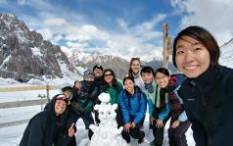
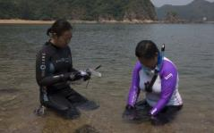
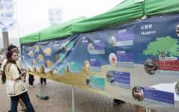
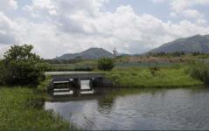
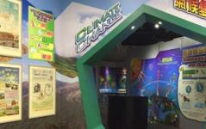
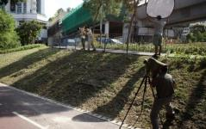
Our works
海外生態體驗
Overseas Eco-programs
生物多樣性調查
Biodiversity Survey
公眾展覽及教育活動
Public Exhibition & Education Program
濕地管理
Wetland Management
漁農自然護理署遊客中心管理
Management of AFCＤ’s
Country Park Visitor Centre
媒體合作及影片製作
Media Co-operation and
Video Production
出版 / 手機應用程式
Publication and Mobile Application
產品設計
Product Design

Slide 3
What is Ecotourism?
“It is a responsible travel to natural areas that conserves the environment and improves the well-being of local people.”
Definition by
The International Ecotourism Society
Ecotourism is a kind of environmental education!

Slide 4
Resent trend of overseas study tours in Hong Kong
Start at age 7 or above
Parent-child mainly visit Singapore, Japan, Korea ( 10%)
School increasingly travel England, Australia & Germany
( 30%)
Start visiting “One Belt One Road” countries

Slide 5
Turning overseas study tours to ecotours. Adding nature conservation experience to participants!

Slide 6
Learning process
Knowledge gain
Attitude change
Action change

Slide 7
Six key elements of overseas ecotour programme design

Slide 8
1. Visit to Zoo / Aquarium/ Wildlife re-habitation centre / sanctuary
2. Fieldtrip at nature reserve
3. Experience quick wildlife survey, BioBlitz
Provide rich information on natural environment and wildlife at the area.
Exploration of the exotic natural environment that need protection.
Experience the work of scientist on wildlife survey. Make students reliased the amazing biodiversity of the area.

Slide 9
4. Fieldtrip of the geographic landscapes
5. Experience local cultural / economical activities
6. Build the environmental friendly living habit
Understand the geographic landscapes that shape the habitats and ecosystems in the area.
Experience the living of local people with their natural envrionment.
Practicse reduce, reuse, recycle and rethink in daily life during the travel.

Slide 10
Taiwan Ecotours
Designed by ERC

Slide 11
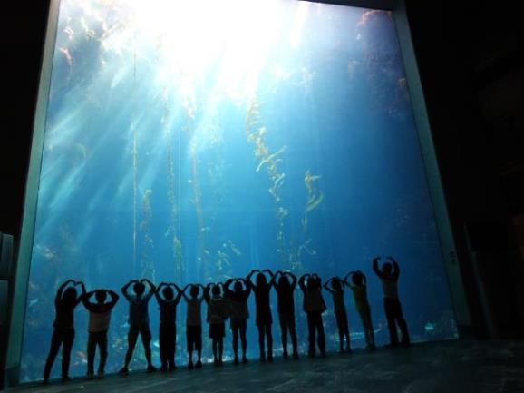
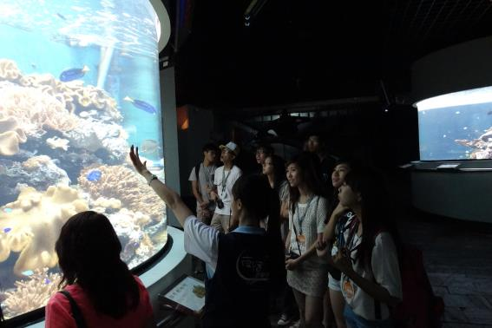
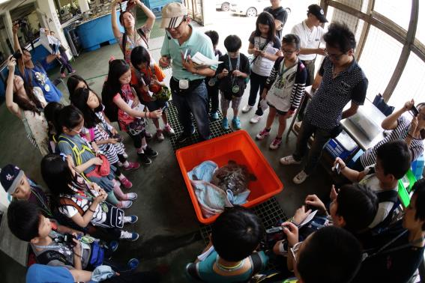
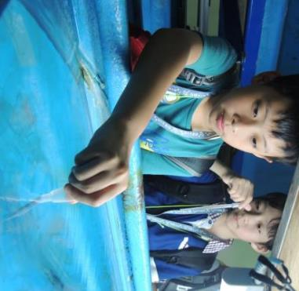
1. Visit to National Museum of Marine Biology & Aquarium
Kenting, Taiwan

Slide 12
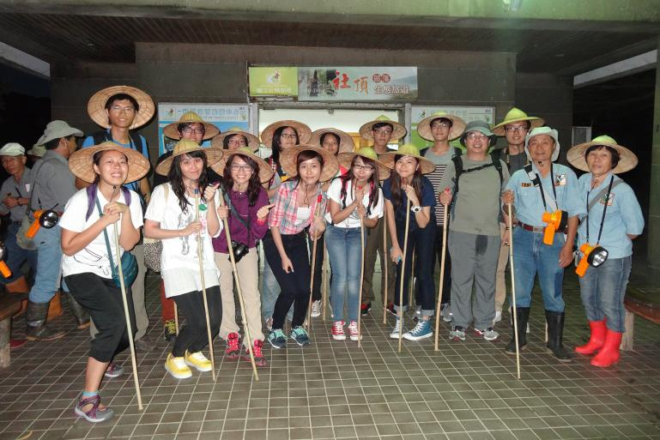
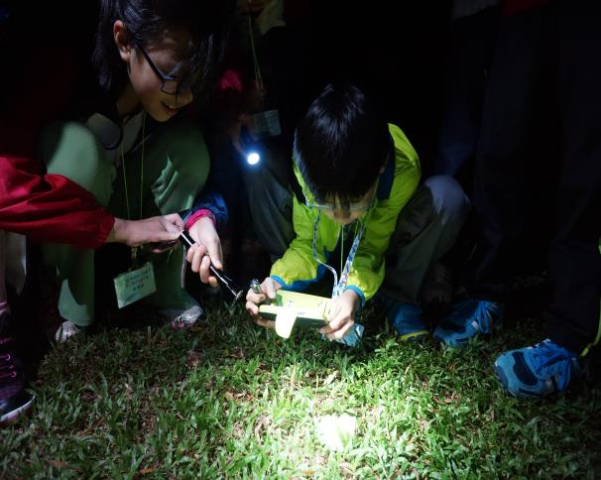
2. Night search at Sheding Park to have BioBlitz at Kenting National Park area
Kenting, Taiwan

Slide 13
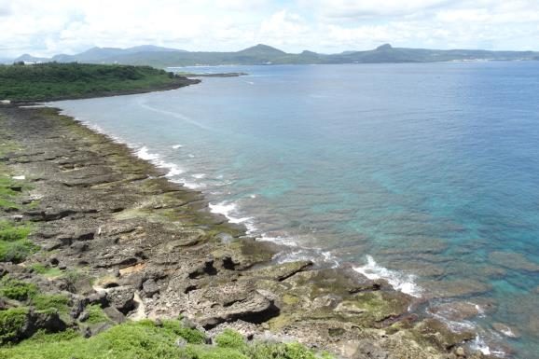
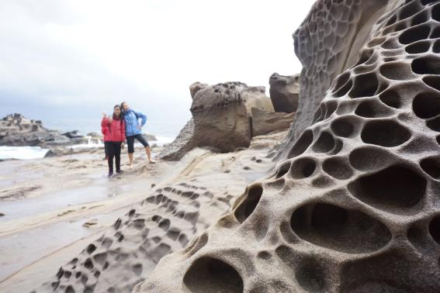
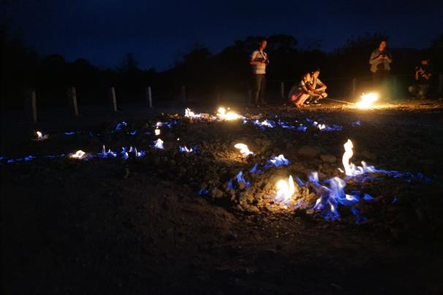
3. Fieldtrip to shoreline with uplifting coral reef and specially weathered landscapes
Kenting, Taiwan

Slide 14
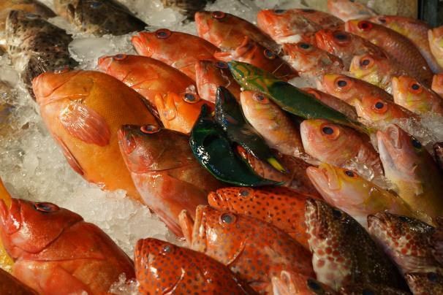
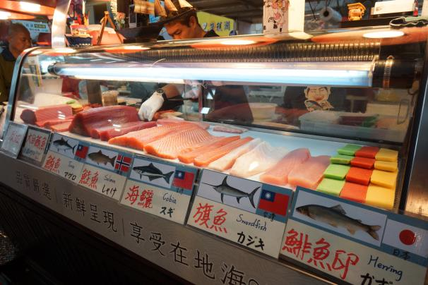
4. Visiting famous fish market of the area
Kenting, Taiwan

Slide 15
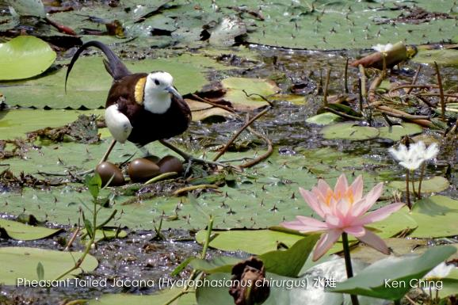
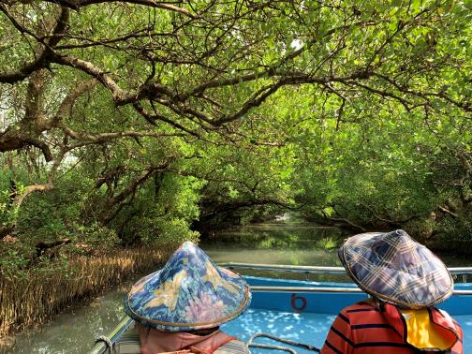
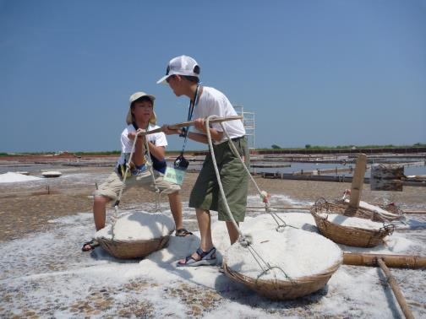
Visit to Guantian Jacana Ecological Park, Sicao Mangrove Protection Area, traditional tile paved salt fields and fossil digging experience
Other Taiwan tour: Tainan

Slide 16
Sabah Ecotours
Designed by ERC

Slide 17
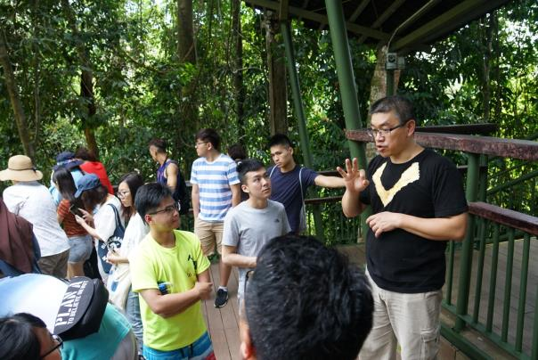
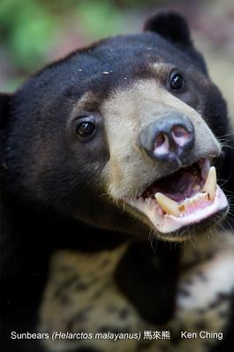
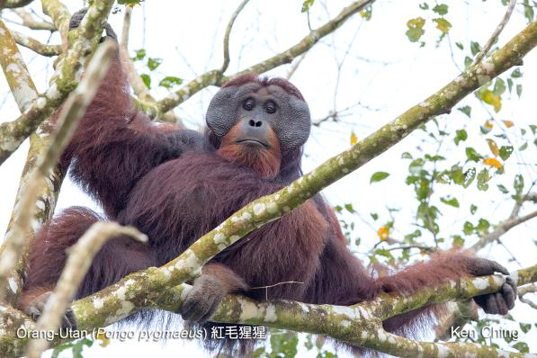
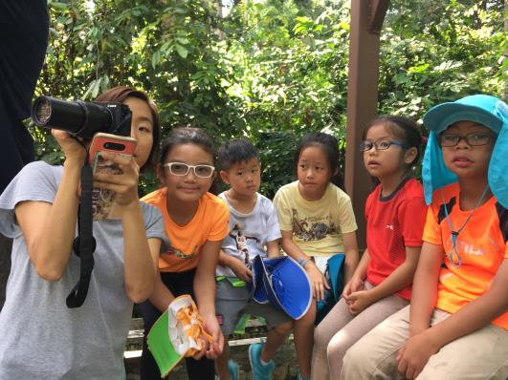
1. Visit to Sepilok Orangutan Rehabilitation Centre and Bornean Sun Bear Conservation Centre
Sandakan, Sabah

Slide 18
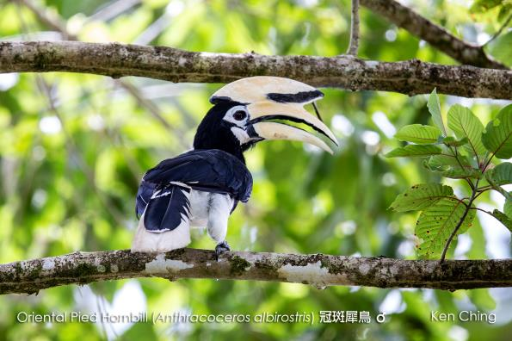
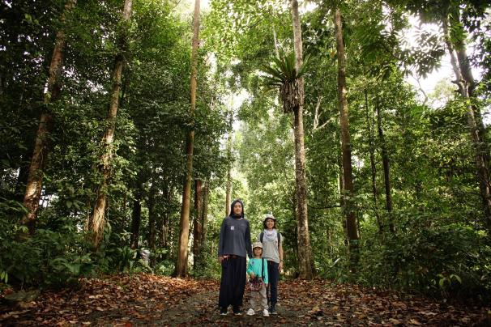
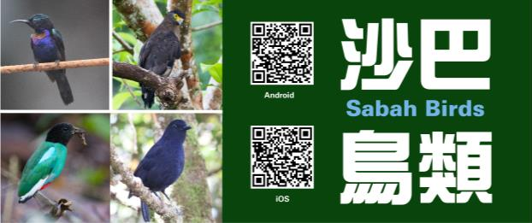
2. Exploration at Rainforest Discovery Centre located in Kabili-Sepilok Forest Reserve and have BioBlitz on birds through smartphone application
Sandakan, Sabah

Slide 19
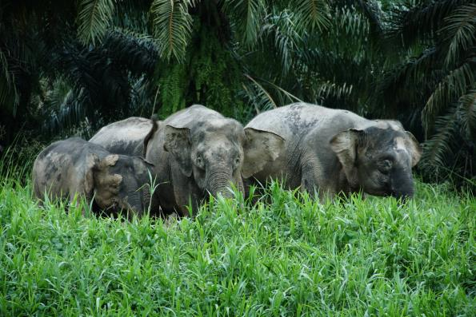
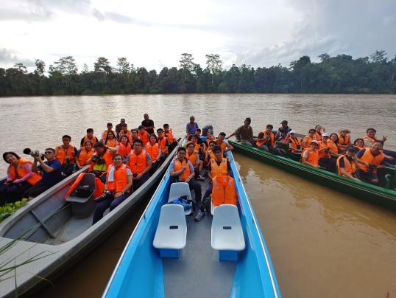
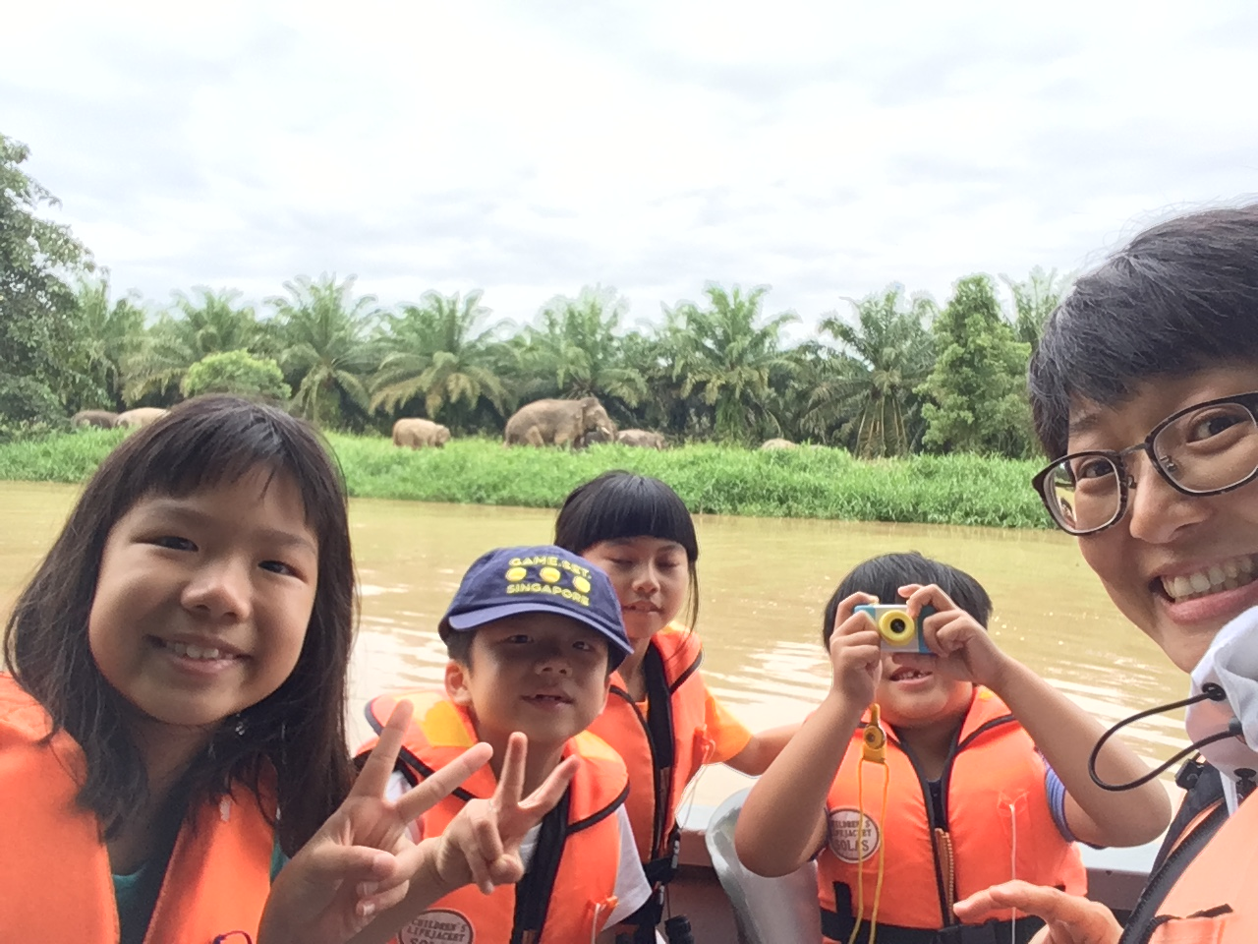
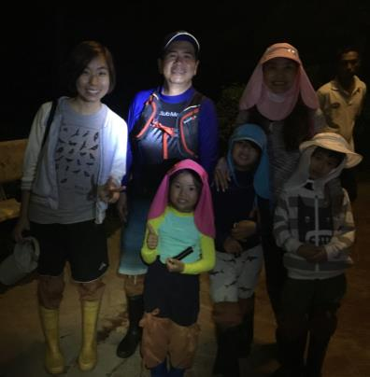
3. Exploration at “Little Amazon” in Asia, the Kinabatangan River
Sandakan, Sabah

Slide 20
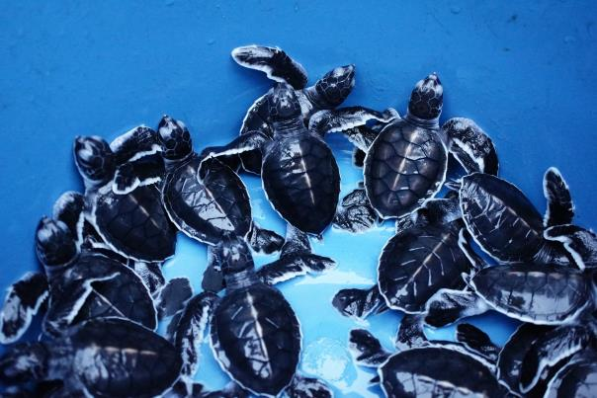
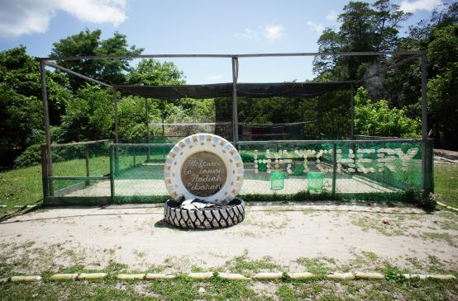
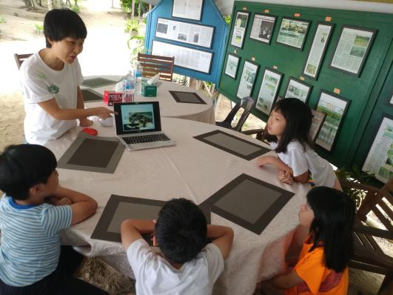
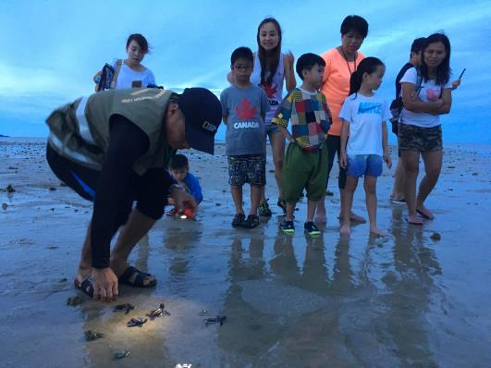
4. Visit turtle island to learn the conservation work on endangered sea turtles
Sandakan, Sabah

Slide 21
FUTURE DIRECTION Promoting nature conservation locally with joint force. Zoos, aquariums, nature conservation organizations, ecotourism industries can extend their influencing power!

Slide 22
Keep in touch &
exchange idea
FaceBook
Email:
carolliu.erc@gmail.com
erc.org.hk@gmail.com
Place your screenshot here

Slide 23
Q & A Thank You

